Slide 1
Competitive Programming
06 Oct. 2023
Andrei Novikov

Slide 2
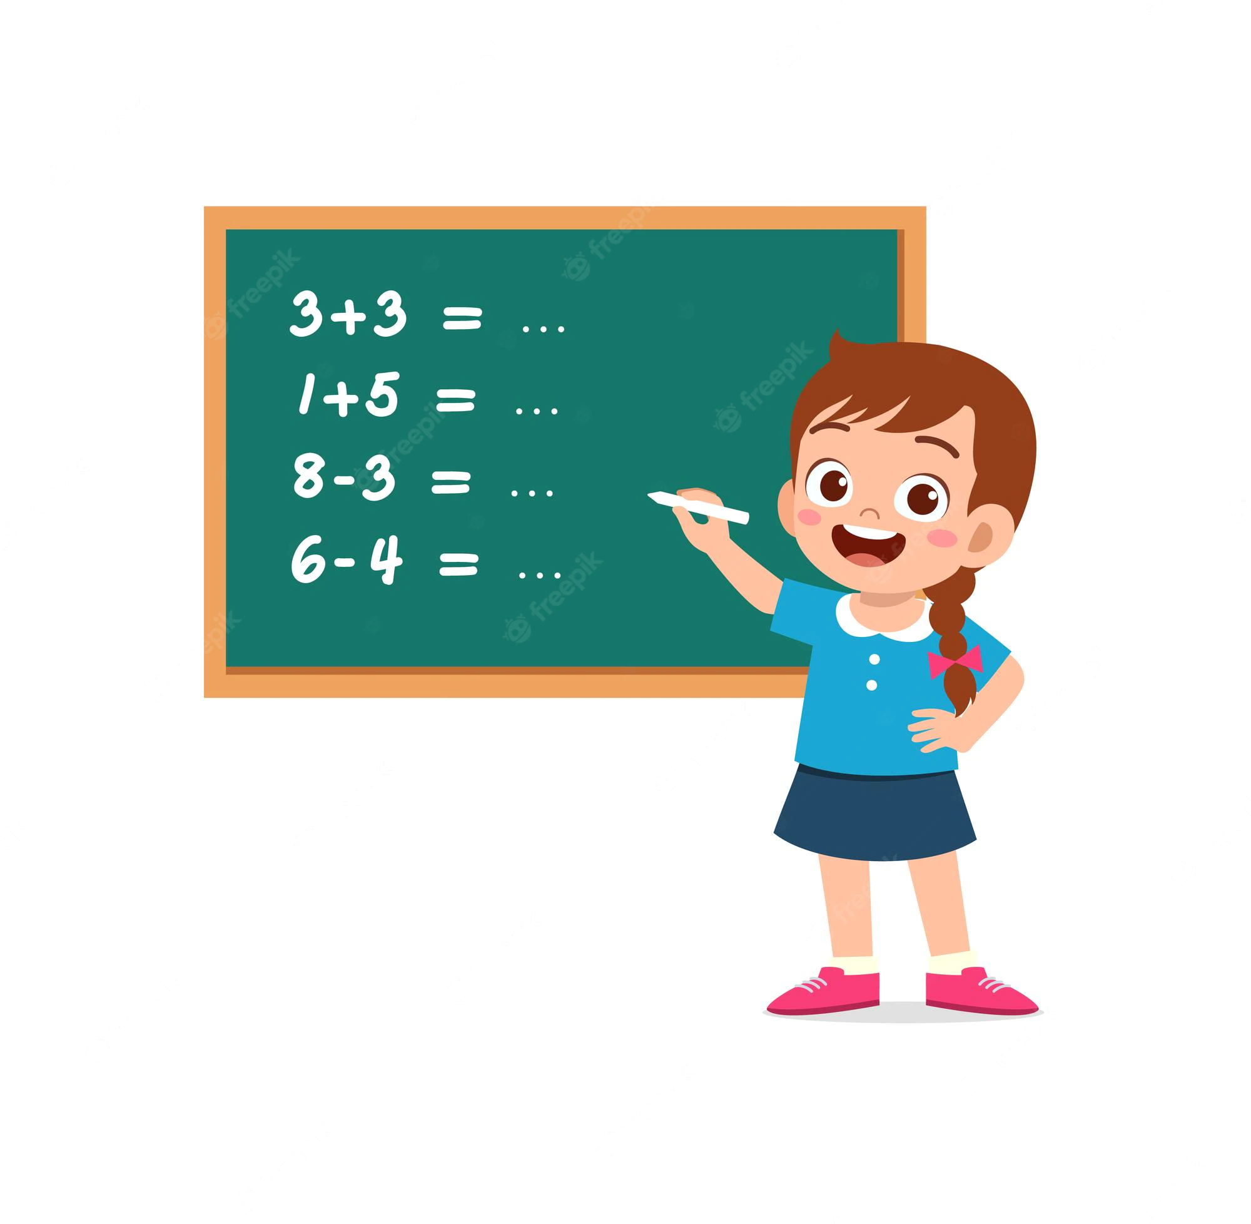
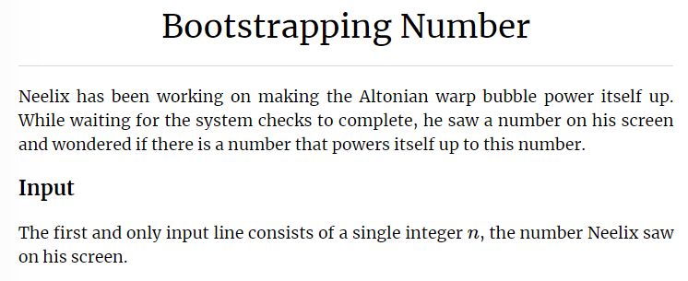
Practice – Search Problem Example
Solve the problem:
Kattis. Bootstrapping Number – Link

Slide 3
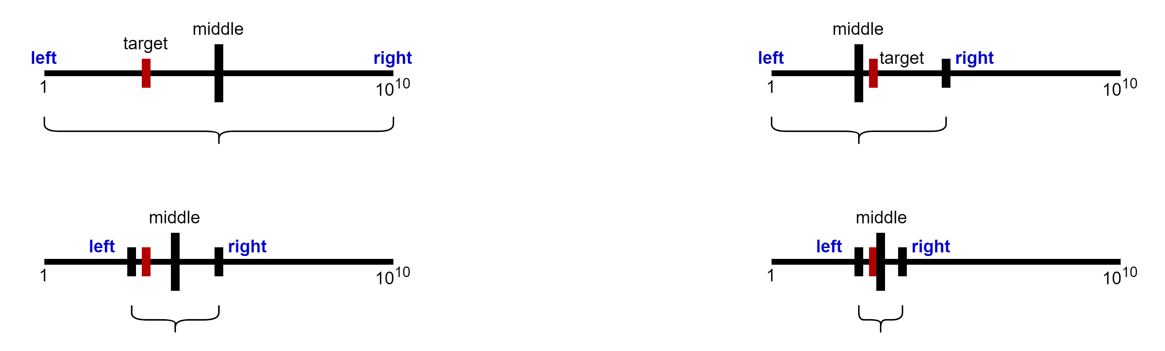
Practice – Binary Search
Bisection method
Solve the problem:
Kattis. Bootstrapping Number – Link
Binary search algorithm
1
2
3
4

Slide 4
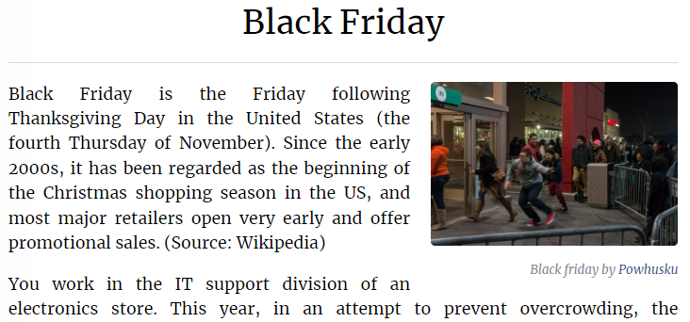
Practice – Iterative Search
Solve the problem:
Kattis. Black Friday – Link

Slide 5
Hometask
Practice from Competitive Programming 4:
Chapter 3.2:
Kattis. Card Trick – Link – Easy one – entry level
Kattis. 4 Thoughts – Link – Looks more interesting and complex

Slide 6
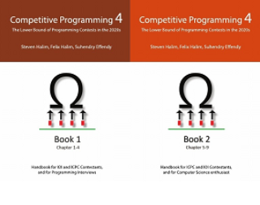
How to Learn and Practice
As one of the recommendation is to use:
Book Competitive Programming 4
Kattis – Link
Online Judge – Link
LeetCode - Link
Few Theory
A Lot of Practice
A Lot of Theory
Almost No Practice

